Slide 2
Project Management
IS3430

Slide 3
PM and Communication
Symbols, letters, words
Vocabulary building
Daily records
  Hand written –
  scanned and uploaded (within 24 hours)
  partial record for proof of attendance

Slide 4
Assignments and end semester exam
End semester 67%
Assignments 33%

Slide 5
Assignments
In class
Take-home
Individual
Group
ADDITIONAL assignments for missed classes

Slide 6
Assignments for today
Individual
  In class
  Take home

Slide 7
Additional assignments for missed classes
Two components
Deadline
Value

Slide 8
Additional assignments for missed classes
Two components
  Work assigned as take home assignment
  Summary report covering subject areas discussed in class (handwritten)
Deadline
  To be uploaded within 72 hours from the time of return to faculty
Value
  Excuses for “Absence” will not be considered without timely submission of additional assignment for missed class (absence).

Slide 9
In Class Assignment
Mandatory Information
Date and time18th July 2016 1300hrs
Name: SPP de Silva 134333Q
Row number 3 ,
L:SU Perera135202S ( or aisle) ,
R: CSD Fernando 114323R ( or aisle)

Slide 10
අනිවාර්ය Mandatoryகட்டாய Information in class Assignment
Date and time18th July 2016 1300hrs
Name: SPP de Silva 134333Q
Row number 3 ,
LN:SU Perera135202S ( or aisle) ,
RN CSD Fernando 114323R ( or aisle)

Slide 11
TIME

Slide 12
Vocabulary
Communication
Activity
Time
Duration
Timing
Sequence
Schedule

Slide 13
Vocabulary
Start
Finish
Landmark
Milestone
Aisle
Notes:
Kurudu gaha hetemma

Slide 14
In class assignment
Time available is 600 seconds. Three questions
List your SGPA for L1S1,L1S2 and L2S1 results
How many types of assignments are there for the subject module IS 3430?
Write a short note to a friend (who missed this class) explaining the value and content of each type of assignment.

Slide 15
Timer
Ten minutes start nowKalimba.mp3 Kalimba.mp3
Two five minute slots

Slide 16
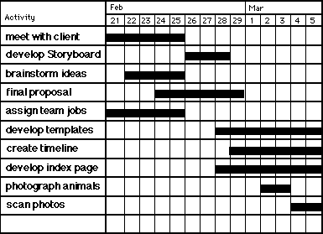
Gantt Chart

Slide 17
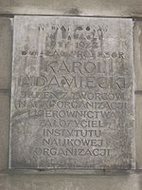

Slide 18
Gantt Charts
Gantt charts provide a standard format for displaying project schedule information by listing project activities and their corresponding start and finish dates in a calendar format
Symbols include:
  A black diamond: milestones or significant events on a project with zero duration
  Thick black bars: summary tasks
  Lighter horizontal bars: tasks
  Arrows: dependencies between tasks

Slide 19
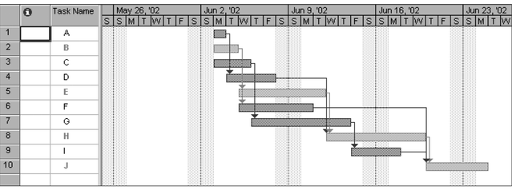
Figure 5-5. Gantt Chart for Project X
Project 98 file

Slide 20
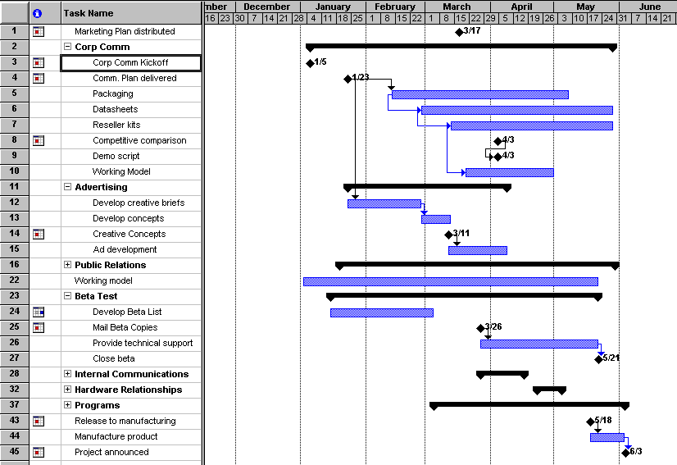
Figure 5-6. Gantt Chart for Software Launch Project
Project 98 file

Slide 21
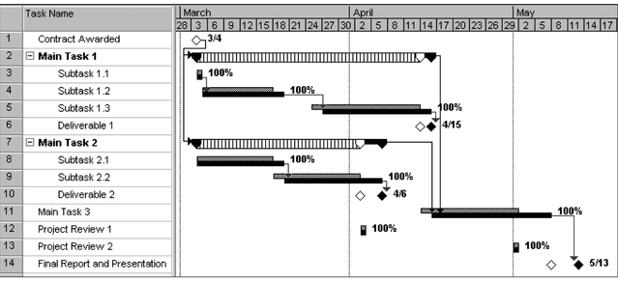
Figure 5-7. Sample Tracking Gantt Chart
white diamond: slipped milestone
two bars: planned and actual times
Project 98 file

Slide 22
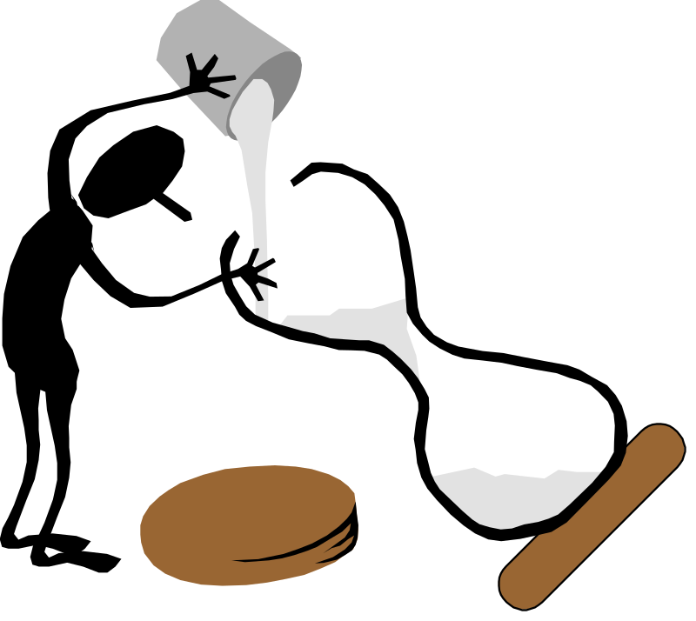
Time Management
Kathleen Riepe
Learning Assistance
Riepe@uwp.edu
University of Wisconsin-Parkside
2002c
Notes:
1

Slide 23
References
Becoming A Master Student, 8th edition.
  Dave Ellis. Houghton Mifflin. 1997
How to Study in College, 6th ed.
  Walter Pauk. Houghton MIfflin. 1997
College Reading & Study Skills, 2nd ed
  Kathleen McWhorter. Harper Collins. 1997
Secrets Our Body Clocks Reveal
  Perry, Dawson. Macmillan Publishing, 1988
First Things First
  Steven Covey. Simon/ Schuster. 1994
Photos by Don Lintner
  University of Wisconsin-Parkside
Notes:
2

Slide 24
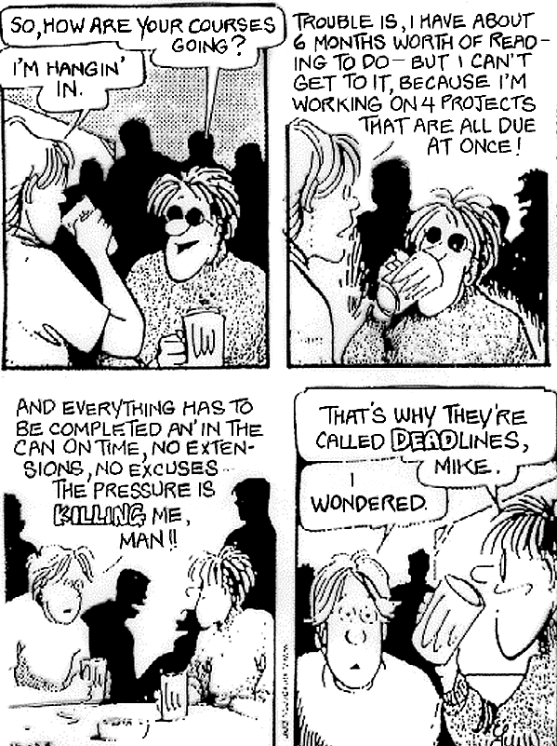
Notes:
4

Slide 25
Before you Begin
Make Post-it Reminders
This presentation makes Nine numbered main points.
RIGHT NOW, get ready with 9 bullet points
Write your notes for each bullet point.

Slide 26
Time Management ( slides 25 -79)
1 The Present
2 86,400
3 Tick When I Should Tock?
4 Am I Working My “A’s” Off?
5 Conquer Procrastination
6 Pacing
7 Take the Offensive With a Planner
8 Be Realistic in your Expectations
9 Is The Jar Full?
10 Be the Bunny

Slide 27

1. The Present

Slide 28
1. The Present
Yesterday is History
Tomorrow’s a Mystery
But Today is a Gift
That’s Why They Call it
The Present
Notes:
3

Slide 29
Time is a Non Renewable Resource
  Once it is gone, it is gone.
  You will never see this moment again.

Slide 30

A Fordham University Study of first year students found the following:
  On weekdays students spent TWICE as much time on leisure activities as on studying.
  On weekends students spent SIX TIMES as much time on leisure activities as on studying.
Notes:
5

Slide 31
What’s your “LQ”
Leisure Quotient?
Sometimes we just don’t realize how much time we spent in non productive ways.
Here are some examples of leisure:
  Visiting between classes
  Listening to CD’s
  Watching tv
  Daydreaming
What others can you think of?

Slide 32

Finding your LQ
For the next week, keep a close record each day of how much time you spend on leisure activities.
Divide this number by 960* minutes to get your “LQ”.
  *960 minutes equals 16 waking hours per day.
  Leisure activities are important to help you recharge, but too much can be detrimental.

Slide 33
2. 86,400

Slide 34
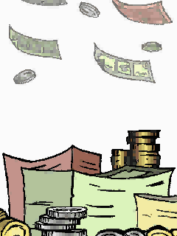
2. Eighty Six Thousand
Four Hundred
Picture this:
  Each day your bank deposits $86,400 in your checking account.
  There’s just one catch.
  You have to spend it all in one day.
  You can’t carry over any money to the next day.

Slide 35
What would you do?
DUH?
You’d spend it all, Right?

Slide 36
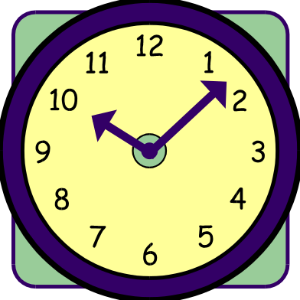
24 hours per day
X
60 minutes per hour
X
60 seconds per minute
=
86,400 Seconds

Slide 37
Every Second Counts
Spend every second in an efficient and productive way
If you fail to use the day’s deposits, the loss is yours.

Slide 38
To Realize the Value of:
ONE YEAR, ask a student who failed a grade.
ONE MONTH, ask a mother who gave birth to a premature baby.
ONE WEEK, ask the editor of a weekly newspaper.
ONE DAY, ask a daily wage laborer with kids to feed.
ONE HOUR, ask the lovers who are waiting to meet.
ONE MINUTE, ask a person who missed the train.
ONE SECOND, ask a person who just avoided an accident.
ONE MILLISECOND, ask the person who won a silver medal in the Olympics.

Slide 39
3. Tick When I Should Tock?

Slide 40
3. Am I trying to Tick when my Body Wants to Tock?
Circadian Rhythms
  Circadian rhythms are internal biological clocks that regulate many functions and activities, including sleep, temperature, metabolism, alertness, blood pressure, heart rate and hormone levels and immunities.
  About every 24 hours our bodies cycle through metabolic and chemical changes.
  These Circadian Rhythms are reset by sunlight each morning.
  Whether you are a “Morning Person” or a “Night Owl” is determined by these cycles.
Notes:
7

Slide 41
Maximize your Efficiency
Work With Your Body Cycles-not Against Them
If we learn to listen to our bodies, we can work with these natural rhythms instead of fighting them.
We can make more efficient use of our time by scheduling certain activities at certain times of the day.

Slide 42
Cognitive Tasks
8am - 12 noon*
Cognitive, or mental, tasks such as reading, calculating, and problem solving are performed most efficiently in the morning.
*If you are a Night Owl, shift these times about 3-4 hours later in the day.

Slide 43
Short term memory
6 am - 10 am
Short term memory tasks such as last minute reviewing for tests are best performed early in the morning.
*If you are a Night Owl, shift these times about 3-4 hours later in the day.

Slide 44
Long term memory
1 pm - 4pm*
Longer term Memory tasks such as memorizing speeches and information for application are best performed in the afternoon.
*If you are a Night Owl, shift these times about 3-4 hours later in the day.
Notes:
8

Slide 45
Manual Dexterity
2 pm to 6 pm*
You are most efficient at tasks involving the use of your hands such as keyboarding and carpentry in the afternoon and early evening.
*If you are a Night Owl, shift these times about 3-4 hours later in the day.

Slide 46
Physical Workouts
4 pm to 9 pm *
  Because of Circadian Rhythms it is best to engage in physical activity in the evening when your large muscle coordination is at its peak.
  Studies show you will perceive the workout to be easier in the evening.
  Exercising about 5 hours before bedtime improves the quality of sleep.
*If you are a Night Owl, shift these times about 3-4 hours later in the day.

Slide 47
Student Lag, aka Jet Lag
Are you creating the equivalent of jet lag by keeping an inconsistent sleep schedule?
Answer the following questions to find out.

Slide 48
Do you Suffer from
Student Jet Lag?
Do you get up at about the the same time each morning?
Yes___No____
Do you wake up without an alarm most mornings?
Yes___No____
Do you almost always get 7-9 hours of sleep per night?
Yes___No____

Slide 49
Student Jet Lag
If you answered no to any of the questions, you are compromising your body’s efficiency.

Slide 50
Learn more about Circadian Rhythms
Secrets of Our Body Clocks Revealed
  Perry, Dawson. Macmillan Publishing, 1988

Slide 51
4. Am I Working My “A’s” Off?

Slide 52

4. Am I Working My “A’s” Off?
Economist Vilfredo Pareto identified the 80/20 Rule.
  In any list of tasks, 80% of the importance lies in 20% of the list.
Notes:
9

Slide 53
How would prioritize this list of daily tasks?
Write the underlined word of the tasks which would be on your
“A” List
“B” List
“C” List
Buy laundry detergent.
Write a eight page essay for English.
Prepare for a Biology quiz.
Dust the videos on the bookcase.
Review for midterm test that counts for 50% of grade.
Schedule an appointment with a Professor.
Complete a journal entry.
Email a high school friend on another campus.
Shop for a new pair of athletic shoes.
“Armor-al” the dashboard of the car.
Notes:
10

Slide 54
Are you working your “A’s” Off? or
Do You Have C-Fever?
“A” LIST
  1 Midterm test that counts for 50% of grade.
  2 Write a eight page essay for English.
“B” LIST
  3 Prepare for a quiz in Biology.
  4 Schedule an appointment with a Professor.
  5 Complete a journal entry.
“C” LIST
  6 Buy laundry detergent.
  7 Dust the videos on the bookcase.
  8 Email a high school friend on another campus.
  9 Shop for a new pair of athletic shoes.
  10 “Armor-al” the dashboard of the car.
Notes:
11

Slide 55
“C” Fever
Have you ever noticed?
  That the videos must be alphabetized before you can settle in to review for a test.
  That rumpled pile of clothes left in the corner since Thursday night just has to get folded and put away before you can start that English essay.
If so, you may be suffering from “C” Fever

Slide 56
5. Conquer Procrastination

Slide 57
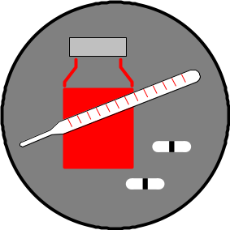
5. Conquer Procrastination
Why is “C” fever as common as the cold?
  The “A” tasks may :
    Produce minimal endorphins
    Be too lengthy
    Be too difficult
    Be too threatening because of the possibility of failure
    Be too threatening because of the possibility of success
Notes:
12

Slide 58


It’s All about Endorphins - The Feel Good Hormone
Develop a Conditioned Response to the Tasks you Procrastinate
Set a goal to complete a task/project
After completing the task, reward yourself with something that is pleasurable for you
The body releases endorphins- the feel good hormone
Over time with repetition, you will come to associate feeling good with completing a task/project
You won’t procrastinate as much

Slide 59
Divide and Conquer Procrastination
A father gave his son a bundle of sticks and asked him to break it. After the boy struggled, the father took the bundle, untied it and broke one stick at a time.
We procrastinate because the “A” tasks seem too lengthy or too difficult
  Divide a lengthy task into smaller, shorter parts that seem easier to complete
  Divide a forty page chapter into 10 page sections
  Reward yourself after completing each section.

Slide 60
Fear of Success and Failure
We procrastinate because we fear FAILURE.
  It is easier to accept that we failed because we didn’t even attempt a project than to fail at doing the project.
We procrastinate because we fear SUCCESS.
  If I get all “A’s” this semester, everyone will expect the same next semester.
  If I do an outstanding job on this project, my boss will just pile on more work.

Slide 61
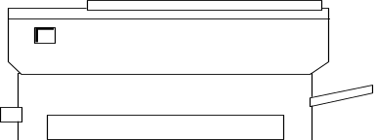


If you are going to Procrastinate, at least take the blame!
  Student to Teacher…
  “I don’t have my paper today because the lab assistant couldn’t get the printer to work.”
  “I’m late to class because I couldn’t find a parking space.”
  “I’d like to study on a regular basis, but it isn’t always possible with my hectic sleeping schedule!”
Notes:
6

Slide 62
6. Pacing

Slide 63


6. Pacing
Athletes know the phenomenon of running with someone ahead of them to increase their times.
The same effect can be achieved with studying and completing schoolwork.
Notes:
13

Slide 64
Because work expands or contracts to fit the time allotted, make pacing work for you by doing the following:
    Estimate the time needed to complete a task.
    Subtract 15% from that estimate.
    Set a timer to help you reach the goal of completing the task in reduced time.

Slide 65
7. Take the Offensive With a Planner

Slide 66

7. Take the Offensive with a
PLANNER
A planner helps you:
  See the big picture
  Plan ahead to avoid “11th Hour” efforts
  Be time efficient
Notes:
14

Slide 67
Using a Planner Effectively
Select a planner that you will be likely to carry with you.
At the beginning of each semester, record test dates, project due dates etc from all of your syllabi for your classes.
Use pencil because schedules change
Keep your planner handy

Slide 68
8. Be Realistic in your Expectations

Slide 69

8. Be Realistic
Examine your schedule.
Be realistic about what you can accomplish.
Don’t try to juggle too many things.
Don’t set yourself up for failure.

Slide 70
The Four to One Rule of Thumb
For every hour you are in class, you should study at least 4 hours
=

Slide 71
UNIVESITY IS A FULL TIME JOB
Full time student spends 12 hours in class per week
Full time student spends a minimum of 48 hours per week studying
12 plus 48 equals 60 hours per week
IT IS A FULL TIME JOB!

Slide 72
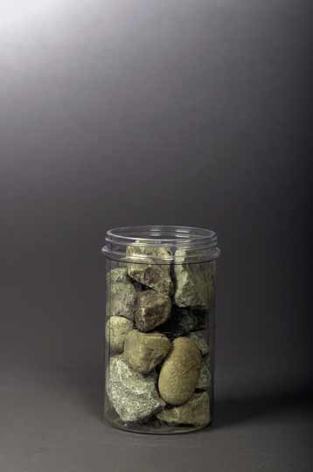
9. Is The Jar Full?
Stephen Covey in his book, First Things First, shares the following story experienced by one of his associates:
I attended a seminar once where the instructor was lecturing on time. At one point, he said, "Okay, time for a quiz." He reached under the table and pulled out a wide-mouthed gallon jar. He set it on the table next to a platter with some fist-sized rocks on it. "How many of these rocks do you think we can get in the jar?" he asked.

Slide 73
After we made our guess, he said, "Okay. Let's find out." He set one rock in the jar . . . then another . . . then another. I don't remember how many he got in, but he got the jar full. Then he asked, "Is this jar full?" Everyone looked at the rocks and said, "Yes."

Slide 74
Then he said, "Ahhh" He reached under the table and pulled out a bucket of gravel. Then he dumped some gravel in and shook the jar and the gravel went in all the little spaces left by the big rocks. Then he grinned and said once more, "Is the jar full?"

Slide 75
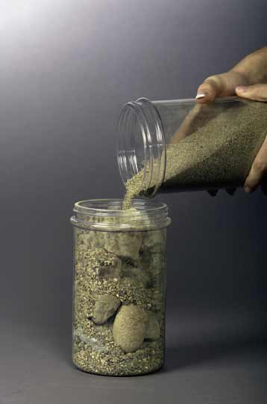
By this time the class was on to him. "Probably not," we said. "Good!" he replied. He reached under the table and brought out a bucket of sand. He started dumping the sand in and it went into all of the little spaces left by the rocks and the gravel. Once more he looked and said, "Is this jar full?" "No!" we roared.

Slide 76
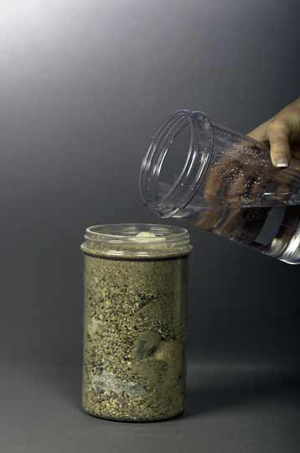
He said, "Good!" and he grabbed a pitcher of water and began to pour it in. He got something like a quart of water in that jar. Then he said, " Well, what's the point?" Somebody said, "Well, there are gaps, and if you work really hard you can always fit some more things into your life."

Slide 77
"No," he said, "that's not really the point.
The point is this:
Put the
Big Rocks
in First

Slide 78
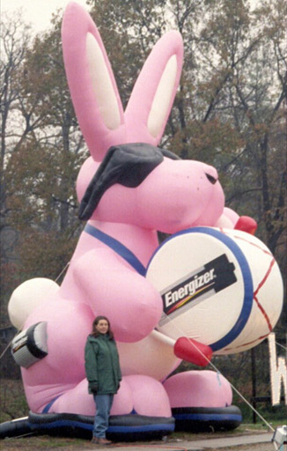
Be The Bunny
Just Keep
  Going
  And going
  And going
  And going
  And going…

Slide 79
1 The Present
2 86,400
3 Tick When I Should Tock?
4 Am I Working My “A’s” Off?
5 Conquer Procrastination
6 Pacing
7 Take the Offensive With a Planner
8 Be Realistic in your Expectations
9 Is The Jar Full?
10 Be The Bunny
Here are the 9 Main Points you have written to remind you how to
Manage Your Time
Notes:
15

Slide 80
Take home assignment
Were you a listener?
Were you an attentive listener?

Slide 81
Since this the first lecture …..
Add to vocabulary
  Attentive
Daily records –
  Hand written –
  scanned and uploaded (within 24 hours)
  partial record for proof of attendance
  is a component of Weekly take home assignment

Slide 82
Weekly take home assignment
Obtaining marks for take home assignment is easy/difficult?
Will attract 5 marks per day with a maximum of 50
To qualify for obtaining the maximum of 5 marks
  the submission should be before stated deadline
  Should include the index numbers of the members sat on the same row
Avoid spelling mistakes which attract negative marks.

Slide 83
Reflection/Did you
Realize the importance of
  vocabulary
  Maintaining handwritten notes

Slide 84
Reflection
Do you know
  Assessment method/marks
  Issues related to attendance
  Eligibility

Slide 85
Reflection
Do this every week
Will help to write the weekly report
Will help to get better grades at the end of the semester examination

Slide 86
Take home assignment –Day 1
It is an individual assignment.
Upload your notes.
Notes to include vocabulary
Notes to include work done with reference slides
REMEMBER: All notes to be handwritten ? (How?)
Dead line : 1200hrs 25th July 2016

Slide 87

First set of reference slides

Slide 88
Activity on Arrow (AoA) diagrams

Slide 89
Elements of an
AoA (Activity-on-Arrow) diagram
Activity (arrow)
  Work element or task
  Can be real or not real
  Name or identification of the tasks (label) must be added
Event (node)
  The start and/or finish of one or more activities
  Tail (preceding) and head (succeeding) nodes

Slide 90
Conventions
Time flows from left to right
  Arrows’ direction
  Labels’ order
Head nodes always have a number (or label) higher that of the tail node. This is the same with the arrow labels (alphabetic order).
Activity labels are placed below the arrow (despite the pictures in the textbook), duration of activity is placed above the arrow
A network has only one starting and only one ending event.
These conventions are not universal. There are many other to choose from.

Slide 91
Graphical representation
Arrows, nodes,
Identification of activities
Representation of time
Representation of deadlines (external constraints)

Slide 92
Dependency rule
b depends on a (b is a successor of a):
1
12
2
13
3
a
b
b and c are independent from each other:
13
3
b
1
12
2
a
8
4
c

Slide 93
Consequences of the dependency rule
An event cannot be realised until all activities leading to it are complete.
No activity can start until its tail event is realised.

Slide 94
Merge and burst nodes
Merge nodes:
  Events into which a number of activities enter and one (or several) leave.
Burst nodes:
  Events that have one (or more) entering activities generating a number of emerging activities.

Slide 95
Two typical errors in logic
Looping: underlying logic must be at fault
Dangling: an activity is undertaken with no result
5
6
e
g
7
f
1
start
2
4
5
end
a
c
d
b
3

Slide 96
Interfacing
When an event is common to two or more subnet works it is said to be an ‘interface’ event between those subnet works and is represented by a pair of concentric circles.
11
13
aa
ab
13
ac
12
22
21
ba
bc
24
bb
24
bd

Slide 97
Milestones
Events which have been identified as being of particular importance in the progress of the project.
Identified by an inverted triangle over the event node (occasionally with an imposed time for the event)
1/1/2014
1
2
3
a
b

Slide 98
Multiple starts and finishes
Only used in computer programs
All starting activities can occur at the start and all finish activities will occur at the end of the project.

Slide 99
Hammock activities
Artificial activities created for the representation of the overhead cost with the aim of cost control.
Embrace activities belong to the same cost centre
Zero duration time (not taking part in the time analysis)
Overhead cost rate is assumed to be constant over the life of the hammock.

Slide 100
Hammock activity
1
12
2
1
3
2
4
a
b
c
0
h
(hammock)

Slide 101
Dummy activities
Activities that do not require resources but may in some cases take time.
They are drawn as broken arrows.
They are always subject to the basic dependency rule.
Three occasions to use dummies:
  Identity dummies
  Logic dummies
  Transit time dummies

Slide 102
Identity dummies
When two or more parallel activities have the same tail and head nodes.
1
4
3
a
3
b
2

Slide 103
Logic dummies
When two chains of activities have a common node yet they are at least partly independent of each other. Hint: examine ANY crossroads.
Example:
  Activitiy c depends on activity a
  Activity d depends on activities a and b
Solution:
  separate c from b with a dummy activity

Slide 104
Logic dummy example:
What is the difference?
2
5
a
c
e
g
1
4
7
b
3
d
f
6
h
2
4
6
c
e
a
g
1
8
b
3
5
7
h
d
f

Slide 105
Transit time dummies
If a delay must occur after the competition of an activity before the successor activity can start.
2
2
4
2
1
a
c
1
5
2
2
b
3
d

Slide 106
Overlapping activities
If the activities are not fully discrete
The second activity can start before the first is completed but not before it is at least partly completed.
1
10
2
15
3
a
b
1
3
2
7
3
a₁
a₂
15
5
b

Slide 107
Activity on Node (AoN) diagrams

Slide 108
Graphical representation
Rectangles instead of circles
Representation of dependency time: lags
(no dummy activities are used)
Artifical Start and Finish activities are used when needed, to have only one beginning and end of the diagram
2
2
4
2
1
a
c
1
5
2
2
b
3
d
a
2
2
c
1
Convert the AoA network above
to an AoN diagram
START
FINISH
b
2
d
2

Slide 109
Elements of an AoN diagram
Activity (node)
  Work element or task
  Name or identification of the tasks must be added
  No need for dummy (unreal) activities
Dependency or sequence arrow
  Shows the interrelationship between activities

Slide 110
CPA, CPM and PERT
Critical Path Analysis (CPA), Critical Path Method (CPM)
  deterministic with only one estimation
Program Evaluation and Review Technique (PERT)
  probabilistic with three estimated durations

Slide 111
Second set of reference slides

Slide 112
Slack Times
EST—Earliest Start Time
  Largest EFT of all predecessors
EFT—Earliest Finish Time
  EST + duration for this task
LFT—Latest Finish Time
  Smallest LST of following tasks
LST—Latest Start Time
  LFT – duration for this task
Slack—LFT – EFT or LST – EST

Slide 113
Network Planning Techniques
Program Evaluation & Review Technique (PERT):
  Developed to manage the Polaris missile project
  Many tasks pushed the boundaries of science & engineering (three time estimates for each task’s duration = probabilistic)
Critical Path Method (CPM):
  Developed to coordinate maintenance projects in the chemical industry
  A complex undertaking, but individual tasks are routine (one time estimate for each task’s duration = deterministic)

Slide 114
Both PERT and CPM
Graphically display the precedence relationships & sequence of activities
Estimate the project’s duration
Identify critical activities that cannot be delayed without delaying the project
Estimate the amount of slack associated with non-critical activities

Slide 115
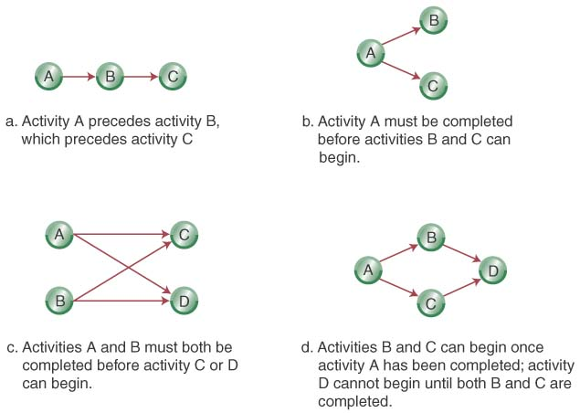
Network Diagrams
Activity-on-Node (AON):
  Uses nodes to represent the activity
  Uses arrows to represent precedence relationships

Slide 116
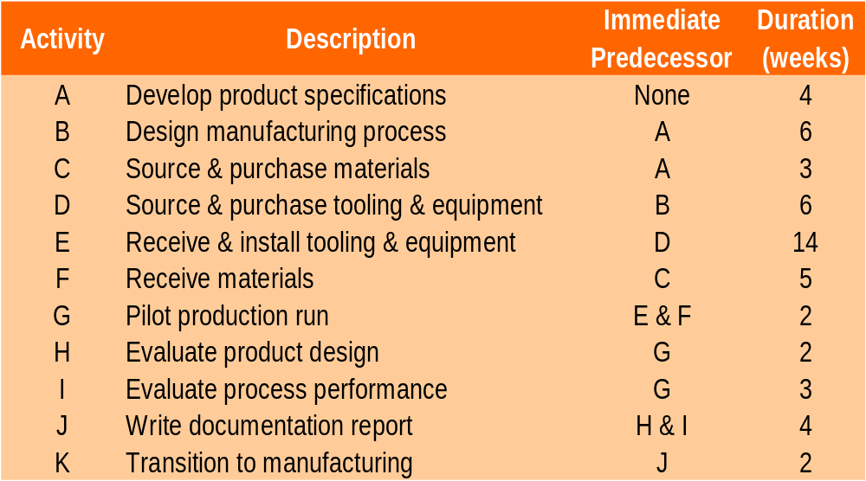
Step 1-Define the Project: Cables By Us is bringing a new product on line to be manufactured in their current facility in some existing space. The owners have identified 11 activities and their precedence relationships. Develop an AON for the project.

Slide 117
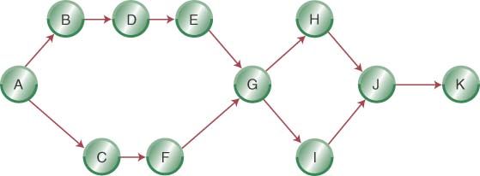
Step 2- Diagram the Network for
Cables By Us

Slide 118
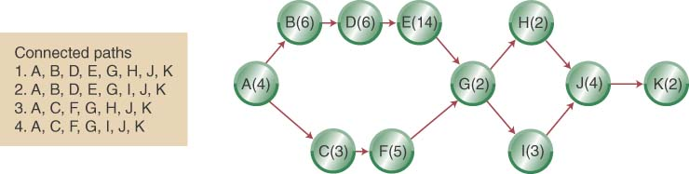
Step 3 (a)- Add Deterministic Time Estimates and Connected Paths

Slide 119
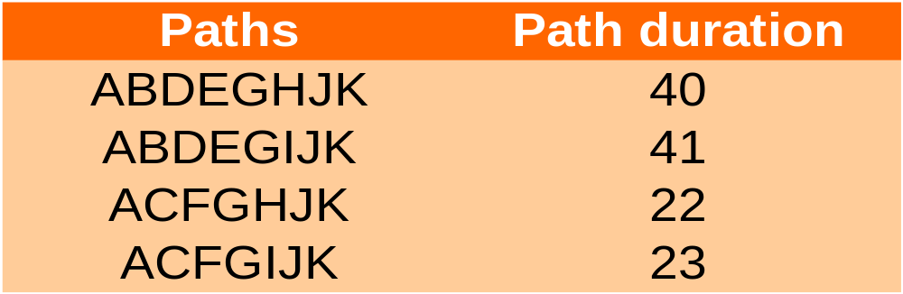
Step 3 (a) (Continued): Calculate the Path Completion Times
The longest path (ABDEGIJK) limits the project’s duration (project cannot finish in less time than its longest path)
ABDEGIJK is the project’s critical path

Slide 120
Some Network Definitions
All activities on the critical path have zero slack
Slack defines how long non-critical activities can be delayed without delaying the project
Slack = the activity’s late finish minus its early finish (or its late start minus its early start)
Earliest Start (ES) = the earliest finish of the immediately preceding activity
Earliest Finish (EF) = is the ES plus the activity time
Latest Start (LS) and Latest Finish (LF) = the latest an activity can start (LS) or finish (LF) without delaying the project completion

Slide 121
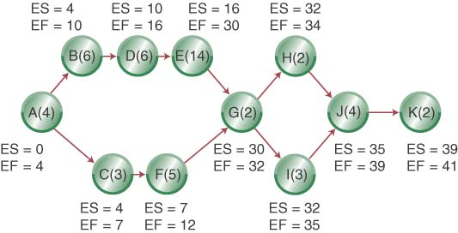
ES, EF Network

Slide 122
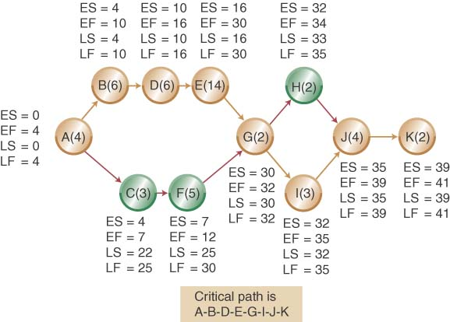
LS, LF Network

Slide 123
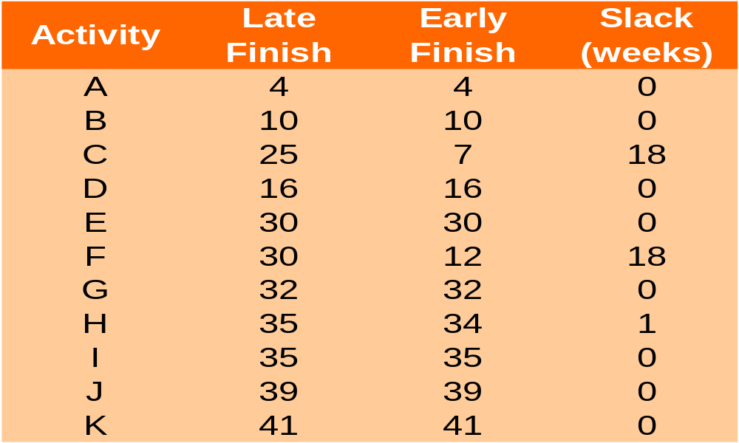
Calculating Slack

Slide 124
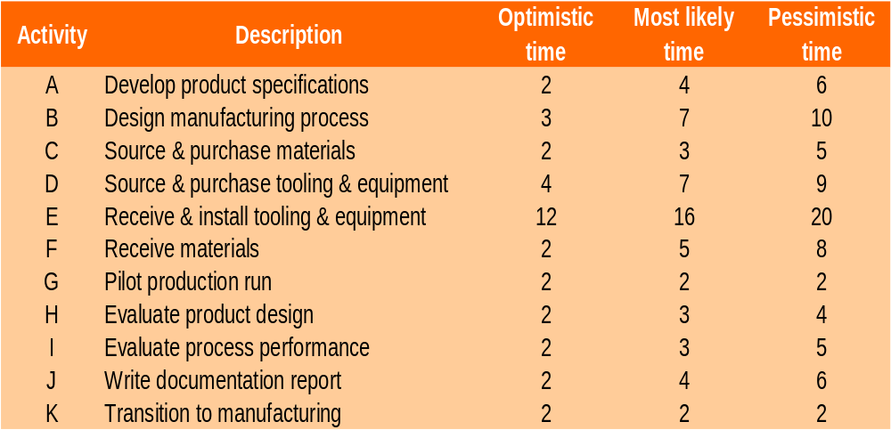
Revisiting Cables By Us Using Probabilistic Time Estimates

Slide 125
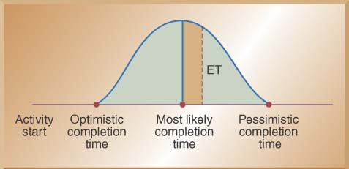

Using Beta Probability Distribution to Calculate Expected Time Durations
A typical beta distribution is shown below, note that it has definite end points
The expected time for finishing each activity is a weighted average

Slide 126

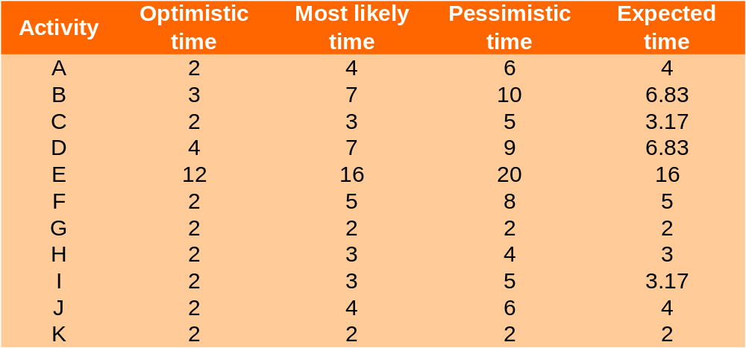
Calculating Expected Task Times

Slide 127
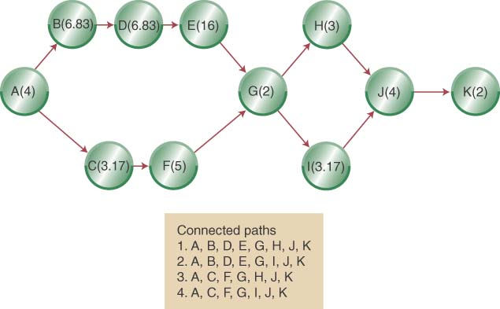
Network Diagram with Expected Activity Times

Slide 128
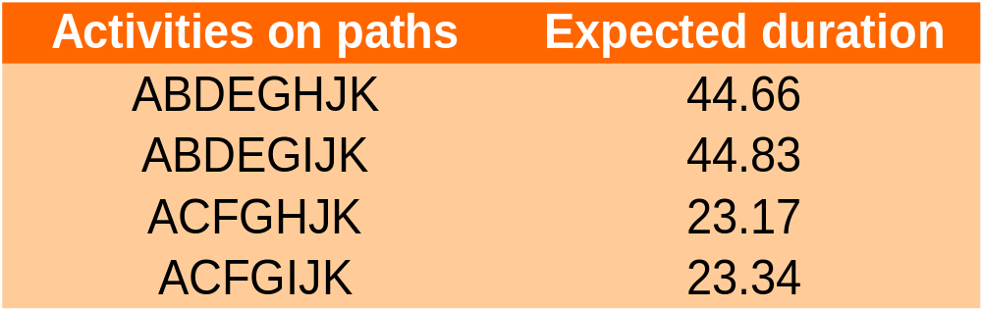
Estimated Path Durations through the Network
ABDEGIJK is the expected critical path & the project has an expected duration of 44.83 weeks

Slide 129
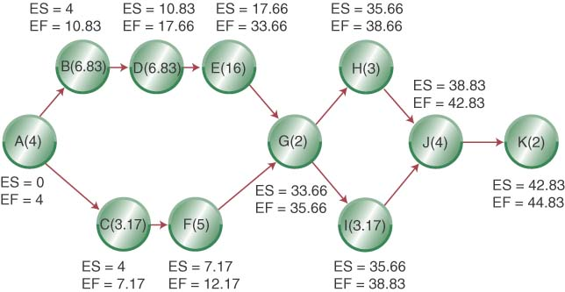
Adding ES and EF to Network

Slide 130
Third set of reference slides

Slide 131
Chapter 5:
Project Time Management

Slide 132
Importance of Project Schedules
Managers often cite delivering projects on time as one of their biggest challenges
Average time overrun from 1995 CHAOS report was 222%; improved to 63% in 2001 study
Time has the least amount of flexibility; it passes no matter what
Schedule issues are the main reason for conflicts on projects, especially during the second half of projects

Slide 133
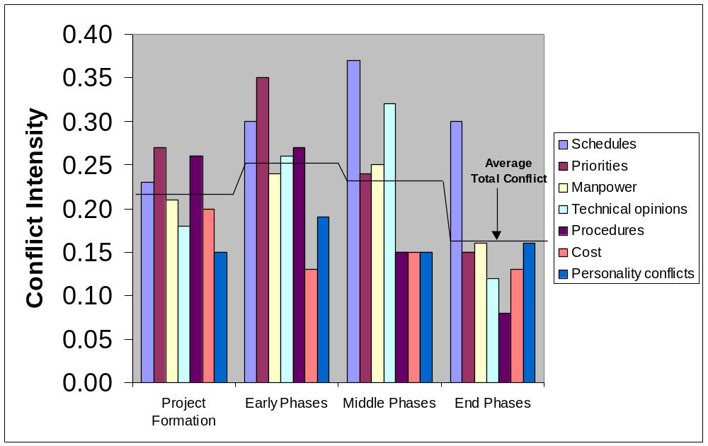
Figure 5-1. Conflict Intensity Over the Life of a Project

Slide 134
Project Time Management Processes
Project time management involves the processes required to ensure timely completion of a project. Processes include:
  Activity definition
  Activity sequencing
  Activity duration estimating
  Schedule development
  Schedule control

Slide 135
Where Do Schedules Come From? Defining Activities
Project schedules grow out of the basic document that initiate a project
  Project charter includes start and end dates and budget information
  Scope statement and WBS help define what will be done
Activity definition involves developing a more detailed WBS and supporting explanations to understand all the work to be done

Slide 136
Activity Sequencing
Involves reviewing activities and determining dependencies
  Mandatory dependencies: inherent in the nature of the work; hard logic
  Discretionary dependencies: defined by the project team; soft logic
  External dependencies: involve relationships between project and non-project activities
You must determine dependencies in order to use critical path analysis

Slide 137
Project Network Diagrams
Project network diagrams are the preferred technique for showing activity sequencing
A project network diagram is a schematic display of the logical relationships among, or sequencing of, project activities

Slide 138
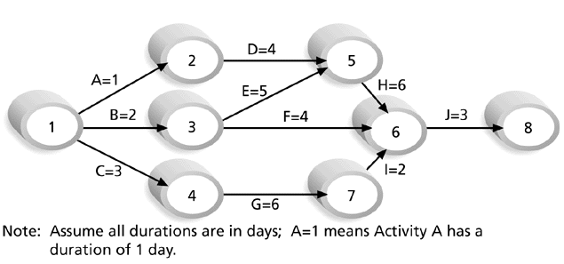
Figure 5-2. Sample Activity-on-Arrow (AOA) Network Diagram for Project X

Slide 139
Arrow Diagramming Method (ADM)
Also called activity-on-arrow (AOA) project network diagrams
Activities are represented by arrows
Nodes or circles are the starting and ending points of activities
Can only show finish-to-start dependencies

Slide 140
Process for Creating AOA Diagrams
1. Find all of the activities that start at node 1. Draw their finish nodes and draw arrows between node 1 and those finish nodes. Put the activity letter or name and duration estimate on the associated arrow
2. Continuing drawing the network diagram, working from left to right. Look for bursts and merges. Bursts occur when a single node is followed by two or more activities. A merge occurs when two or more nodes precede a single node
3. Continue drawing the project network diagram until all activities are included on the diagram that have dependencies
4. As a rule of thumb, all arrowheads should face toward the right, and no arrows should cross on an AOA network diagram

Slide 141
Precedence Diagramming Method (PDM)
Activities are represented by boxes
Arrows show relationships between activities
More popular than ADM method and used by project management software
Better at showing different types of dependencies

Slide 142
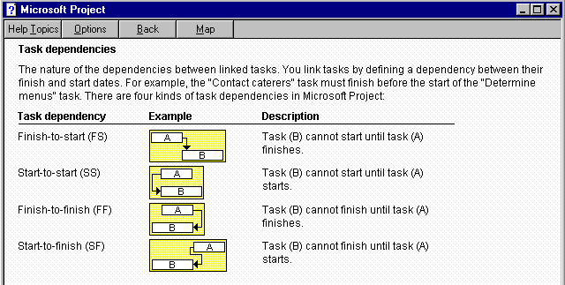
Figure 5-3. Task Dependency Types

Slide 143
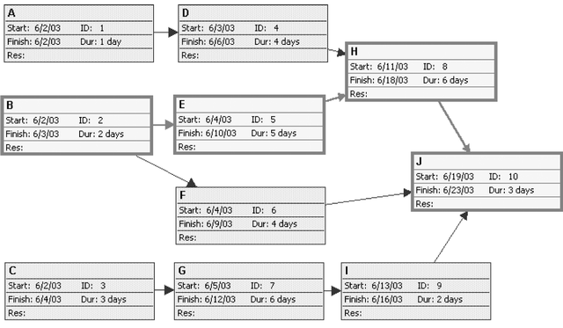
Figure 5-4. Sample Precedence Diagramming Method (PDM) Network Diagram for Project X
Project 98 file

Slide 144
Activity Duration Estimating
After defining activities and determining their sequence, the next step in time management is duration estimating
Duration includes the actual amount of time worked on an activity plus elapsed time
People doing the work should help create estimates, and an expert should review them

Slide 145
Schedule Development
Schedule development uses results of the other time management processes to determine the start and end date of the project and its activities
Ultimate goal is to create a realistic project schedule that provides a basis for monitoring project progress for the time dimension of the project
Important tools and techniques include Gantt charts, PERT analysis, critical path analysis, and critical chain scheduling

Slide 146
Gantt Charts
Gantt charts provide a standard format for displaying project schedule information by listing project activities and their corresponding start and finish dates in a calendar format
Symbols include:
  A black diamond: milestones or significant events on a project with zero duration
  Thick black bars: summary tasks
  Lighter horizontal bars: tasks
  Arrows: dependencies between tasks

Slide 147
Figure 5-5. Gantt Chart for Project X
Project 98 file

Slide 148
Figure 5-6. Gantt Chart for Software Launch Project
Project 98 file

Slide 149
Figure 5-7. Sample Tracking Gantt Chart
white diamond: slipped milestone
two bars: planned and actual times
Project 98 file

Slide 150
Critical Path Method (CPM)
CPM is a project network analysis technique used to predict total project duration
A critical path for a project is the series of activities that determines the earliest time by which the project can be completed
The critical path is the longest path through the network diagram and has the least amount of slack or float

Slide 151
Finding the Critical Path
First develop a good project network diagram
Add the durations for all activities on each path through the project network diagram
The longest path is the critical path

Slide 152
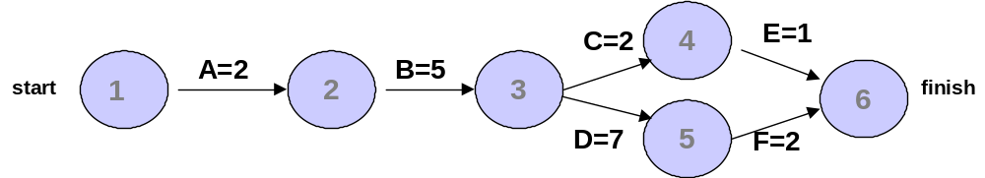
Simple Example of Determining the Critical Path
Consider the following project network diagram. Assume all times are in days.
a. How many paths are on this network diagram?
b. How long is each path?
c. Which is the critical path?
d. What is the shortest amount of time needed to complete this project?

Slide 153
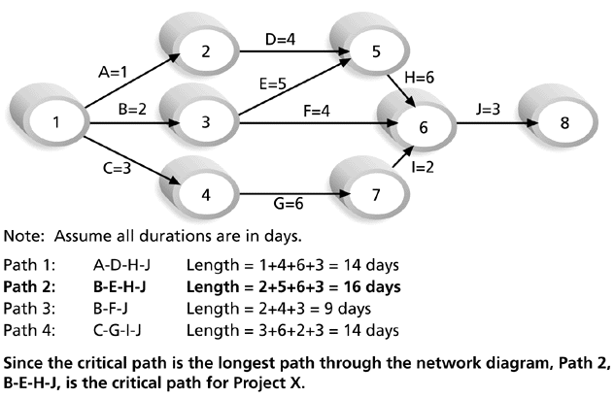
Figure 5-8. Determining the Critical Path for Project X

Slide 154
More on the Critical Path
If one of more activities on the critical path takes longer than planned, the whole project schedule will slip unless corrective action is taken
Misconceptions:
  The critical path is not the one with all the critical activities; it only accounts for time
  There can be more than one critical path if the lengths of two or more paths are the same
  The critical path can change as the project progresses

Slide 155
Using Critical Path Analysis to Make Schedule Trade-offs
Knowing the critical path helps you make schedule trade-offs
Free slack or free float is the amount of time an activity can be delayed without delaying the early start of any immediately following activities
Total slack or total float is the amount of time an activity may be delayed from its early start without delaying the planned project finish date

Slide 156
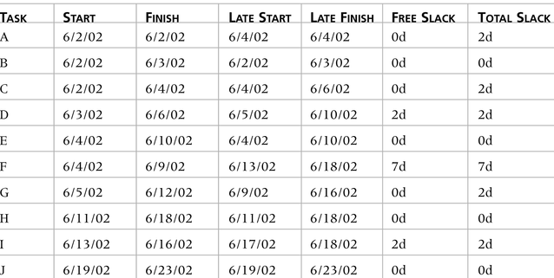
Table 5-1. Free and Total Float or Slack for Project X

Slide 157
Techniques for Shortening a Project Schedule
Shortening durations of critical tasks for adding more resources or changing their scope
Crashing tasks by obtaining the greatest amount of schedule compression for the least incremental cost
Fast tracking tasks by doing them in parallel or overlapping them

Slide 158
Many Horror Stories Related to Project Schedules
See “What Went Wrong?” example about the National Insurance Recording System
Creating realistic schedules and sticking to them is a key challenge of project management

Slide 159
Importance of Updating Critical Path Data
It is important to update project schedule information
The critical path may change as you enter actual start and finish dates
If you know the project completion date will slip, negotiate with the project sponsor

Slide 160
Critical Chain Scheduling
Technique that addresses the challenge of meeting or beating project finish dates and an application of the Theory of Constraints (TOC)
Developed by Eliyahu Goldratt in his books The Goal and Critical Chain
Critical chain scheduling is a method of scheduling that takes limited resources into account when creating a project schedule and includes buffers to protect the project completion date
Critical chain scheduling assumes resources do not multitask because it often delays task completions and increases total durations

Slide 161
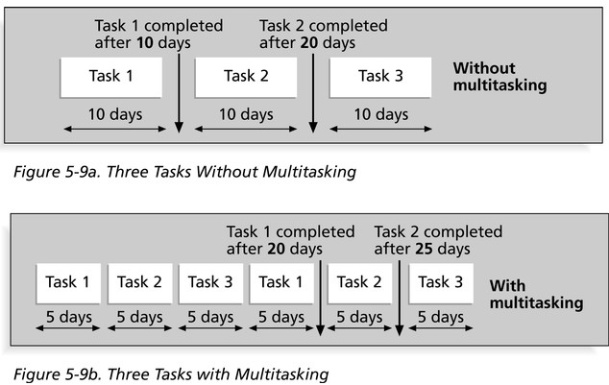
Multitasking Example

Slide 162
Buffers and Critical Chain
A buffer is additional time to complete a task
Murphy’s Law states that if something can go wrong, it will, and Parkinson’s Law states that work expands to fill the time allowed. In traditional estimates, people often add a buffer and use it if it’s needed or not
Critical chain schedule removes buffers from individual tasks and instead creates
  A project buffer, which is additional time added before the project’s due date
  Feeding buffers, which are addition time added before tasks on the critical path

Slide 163
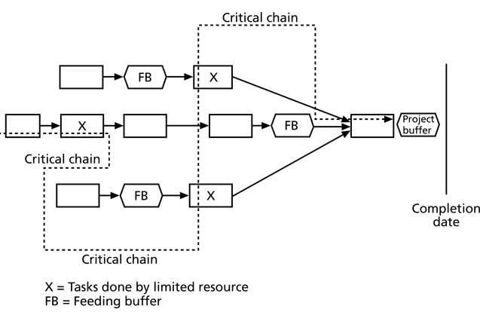
Figure 5-10. Example of Critical Chain Scheduling

Slide 164
Program Evaluation and Review Technique (PERT)
PERT is a network analysis technique used to estimate project duration when there is a high degree of uncertainty about the individual activity duration estimates
PERT uses probabilistic time estimates based on using optimistic, most likely, and pessimistic estimates of activity durations

Slide 165
PERT Formula and Example
PERT weighted average formula:
optimistic time + 4X most likely time + pessimistic time
6
Example:
PERT weighted average =
8 workdays + 4 X 10 workdays + 24 workdays = 12 days 6
where 8 = optimistic time, 10 = most likely time, and 24 = pessimistic time

Slide 166
Controlling Changes to the Project Schedule
Perform reality checks on schedules
Allow for contingencies
Don’t plan for everyone to work at 100% capacity all the time
Hold progress meetings with stakeholders and be clear and honest in communicating schedule issues

Slide 167
Working with People Issues
Strong leadership helps projects succeed more than good PERT charts
Project managers should use
  empowerment
  incentives
  discipline
  negotiation

Slide 168
What Went Right?
Chris Higgins used the discipline he learned in the Army to transform project management into a cultural force at Bank of America. Higgins learned that taking time on the front end of a project can save significant time and money on the back end. As a quartermaster in the Army, when Higgins' people had to pack tents, he devised a contest to find the best way to fold a tent and determine the precise spots to place the pegs and equipment for the quickest possible assembly. Higgins used the same approach when he led an interstate banking initiative to integrate incompatible check processing, checking account, and savings account platforms in various states…He made the team members analyze, plan, and document requirements for the system in such detail that it took six months just to complete that phase. But the discipline up front enabled the software developers on the team to do all of the coding in only three months, and the project was completed on time.

Slide 169
Using Software to Assist in Time Management
Software for facilitating communications helps people exchange schedule-related information
Decision support models help analyze trade-offs that can be made
Project management software can help in various time management areas

Slide 170
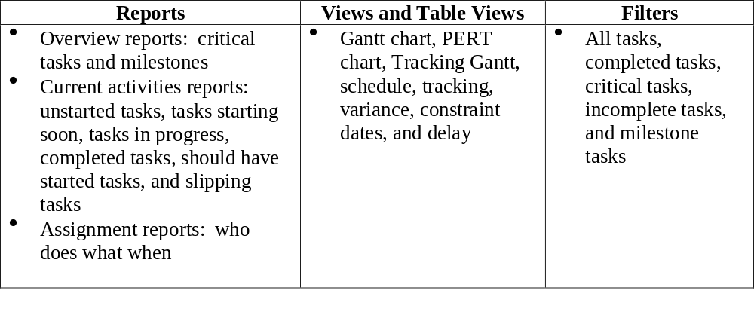
Table 5-2. Project 98 Features Related to Project Time Management

Slide 171
Words of Caution on Using Project Management Software
Many people misuse project management software because they don’t understand important concepts and have not had good training
You must enter dependencies to have dates adjust automatically and to determine the critical path
You must enter actual schedule information to compare planned and actual progress

Slide 172
Fourth set of reference slides

Slide 173
Critical Chain Project Scheduling
Chapter 11
© 2007 Pearson Education

Slide 174
Theory of Constraints &
Critical Chain Project Scheduling
A constraint limits system output.
The Goal – Goldratt
TOC Methodology
Identify the constraint
Exploit the constraint
Subordinate the system
Elevate the constraint
Repeat the process

Slide 175
Variation
Common Cause
Inherent in the system
Special Cause
Due to a special circumstance
Managers should
Understand the difference between the two
Not adjust the process if variation is common cause
Not include special cause variation in risk simulation
Not aggregate discrete project risks

Slide 176
CCPM and the Causes of Project Delay
How safety is added to project activities
Individual activities overestimated
Project manager safety margin
Anticipating expected cuts from management
25%
50%
Gaussian Distribution
80%
90%
time

Slide 177
Wasting Extra Safety Margin
The Student Syndrome
  Immediate deadlines
  Padded estimates
  High demand
Failure to pass along positive variation
  Other tasks
  Overestimation penalty
  Perfectionism
Multitasking
Path Merging

Slide 178
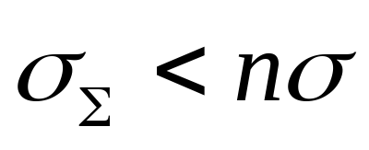
Critical Chain Solutions
Central Limit Theorem
Activity durations estimated at 50% level
Buffer reapplied at project level
  Goldratt rule of thumb
  Newbold formula
Feeder buffers for non-critical paths

Slide 179
CCPM Changes
Due dates & milestones eliminated
Realistic estimates – 50% level not 90%
“No blame” culture
Subcontractor deliveries & work scheduled ES
Non critical activities scheduled LS
Factor the effects of resource contention
Critical chain usually not the critical path
Solve resource conflicts with minimal disruption

Slide 180
Critical Chain Solutions
Feeder Buffer
Bob
Bob
Feeder Buffer
ProjectBuffer
Buffers protect constraints and prevent delays
Feeder Buffer
Bob

Slide 181
Critical Chain Project Portfolios
Drum – system-wide constraint that sets the beat for the firm’s throughput
Drum – person, department, policy, resource
Capacity constraint buffer – safety margin between projects
Drum buffer – extra safety before the constraint

Slide 182
Applying CCPM to Project Portfolios
Identify the drum
Exploit the drum
  Prepare a schedule for each project
  Determine priority for the drum
  Create the drum schedule
Subordinate the project schedules (next slide)
Elevate the capacity of the drum
Go back to step 2

Slide 183
Subordinating Project Schedules
Schedule projects based on drum
Designate critical chain
Insert capacity constraint buffers
Resolve any conflicts
Insert drum buffers so the constraint is not starved

Slide 184
CCPM Critiques
No milestones used
Not significantly different from PERT
Unproven at the portfolio level
Anecdotal support only
Incomplete solution
Overestimation of activity duration padding
Cultural changes unattainable

Slide 185
Fifth set of reference slides

Slide 186
Goldratt’s Critical Chain
In 1997, Goldratt introduced the Critical Chain Project Management (CCPM) methodology to apply the theory of constraints to manage projects.
The CCPM expands on the notion of CPM and the main difference is where to locate time buffers to prevent delaying project completion.
To schedule work is also to schedule resource usages. Link technological precedence with resource availability.
Project management is fundamentally concerned with effectively trading off specifications, cost, and time. Yet, to what extent is the need to make these trade-offs caused by human decisions and practices?
Ardavan Asef-Vaziri

Slide 187
The Critical Chain Concept
A project has four sets of activities that must be completed before a synchronization operation, represented by C4 can be completed.
Use historical data to obtain an estimate of the average time for each activity.
Sum these estimates to obtain the average time it takes each series of activities that must be completed before C4 can begin.
An analysis reveals that the series of activities with the longest average time is C1-C2-C3.
This is the Critical Chain and the activities along the critical chain are termed critical activities.
Ardavan Asef-Vaziri

Slide 188
The Critical Chain Concept
Start Date
A1
A2
Feeding Buffer
Completion Date
B1
B2
Feeding Buffer
C1
C2
C3
C4
Project Buffer
Critical Chain
D1
D2
Feeding Buffer
Time
Ardavan Asef-Vaziri

Slide 189
Estimating Task Times:
3 Project Scenario
The primary difference is the degree of interdependence across the paths.
  Scenario 1: there is only a single path
  Scenario 2: the path B-C-D-E is preceded by three activities A1, A2, & A3. The completion of path B-C-D-E depends on which of its three preceding tasks takes the longest
  Scenario 3: there are two completely independent paths each consisting of five tasks
All three tasks require 10 days to complete.
What completion time would you calculate for each project?
Ardavan Asef-Vaziri

Slide 190
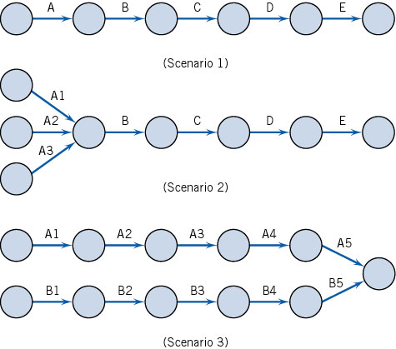
Three Project Scenario
Ardavan Asef-Vaziri

Slide 191
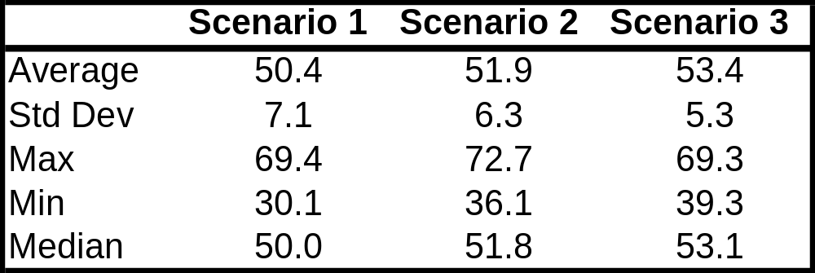
Three Project Scenario
Project times are not known with certainty
Activities that take less than the expected time tend to cancel out the variability of activities that take more than the expected completion time for the project.
Ardavan Asef-Vaziri

Slide 192
Common Chain of Events
According to Goldratt, activities dealing with resource allocation lead to the following chain of events.
  Assuming that the activity times are known and that the paths are independent leads to underestimating the actual amount of time needed to complete the project.
  Because the time needed to complete the project is underestimated, project team members tend to inflate their time estimates.
  Inflated time estimates lead to work filling available time, workers not reporting that a task has been completed early, and the ever-present student syndrome.
  An important caveat than becomes that safety time is usually visible to project workers and is often misused.
Ardavan Asef-Vaziri

Slide 193
Common Chain of Events
  Misused safety time further complicates the task of prioritizing project activities.
  Hidden safety time further complicates the task of prioritizing project activities.
  The lack of clear priorities likely results in poor multitasking.
  Task durations increase as a result of poor multitasking.
  Uneven demand on resources- some overloaded and others underloaded- may also occur as a result of poor multitasking.
  In an effort to utilize all resources fully, more projects will be undertaken to make sure that no resources are underutilized.
  Adding more projects further increases poor multitasking.
Ardavan Asef-Vaziri

Slide 194
Critical Chain Project Management
Identify the critical chain: set of tasks that determine the overall duration of the project
Use deterministic CPM model with buffers to deal with uncertainty
Remove padding from activity estimates (otherwise, slack will be wasted). Estimate task durations at median.
Place project buffer after last task to protect customer’s completion schedule
Exploit constraining resource(s)
Avoid wasting slack times by encouraging early task completions
Have project team focus 100% effort on critical tasks
Work to your plan and avoid tampering
Carefully monitor and communicate buffer status
Ardavan Asef-Vaziri

Slide 195
Sixth set of reference slides

Slide 196
Lecture 4 – PERT Diagrams & CPM
Project Scheduling
Project Scheduling Objectives
Phases of Project Scheduling
PERT Diagrams & Dummy Activities
CPM – Critical Path Method

Slide 197

Project Scheduling
It is part of project management within the Planning phase of the Systems Development Life Cycle.
Project Scheduling: Allocate resources to execute all activities in the project.
Project: Set of activities or tasks with a clear beginning and ending points. The amount of available resources (time, personnel and budget) to carry out the activities is usually limited.
Notes:
Maria Petridou
University of Nottingham

Slide 198
Project Scheduling
Objectives:
  Establish beginning, ending and duration of each activity in the project.
  Calculate overall completion time of the project given the amount of usually limited resources.
  Determine the critical path and its duration.
  Determine the slack time for all non-critical activities and the whole project.
  Guide the allocation of resources other than time such as staff and budget.
Notes:
Maria Petridou
University of Nottingham

Slide 199
Project Scheduling
Phases:
  Define activities or tasks according to the project objectives.
  A task is an individual unit of work with a clear beginning and a clear end.
  Identify precedence relationships or dependencies
  Estimate time required to complete each task.
  Draw an activity-on-arrow PERT diagram inserting dummy activities if required.
  Apply CPM to calculate earliest and latest starting times, earliest and latest completion times, slack times, critical path etc.
  Construct a GANTT chart.
  Reallocate resources and resolve if necessary.
  Continuously monitor/revise the time estimates along the project duration.
Notes:
Maria Petridou
University of Nottingham

Slide 200
PERT Diagrams
Program Evaluation and Review Technique
It is a network model that allows for randomness in activity completion times.
Tool used to control the length of projects.
PERT was developed in the late 1950’s for the US Navy’s Polaris Project.
First used as a management tool for military projects
Adapted as an educational tool for business managers
It has the potential to reduce both the time and cost required to complete a project.
Notes:
Maria Petridou
University of Nottingham

Slide 201
PERT Diagrams
3
B
D
1
A
2
5
F
6
C
E
4
Single start
node
Single finish
node
Notes:
Maria Petridou
University of Nottingham

Slide 202
PERT Diagrams
Activity-on-node diagrams:
  Maybe more than one single start and end node
  Nodes represent activities
  Arrows indicate precedence
Activity-on-arrow diagrams:
  One single start and one single end node
  Arrows represent activities
  Nodes indicate beginning/end of activities
Notes:
Maria Petridou
University of Nottingham

Slide 203
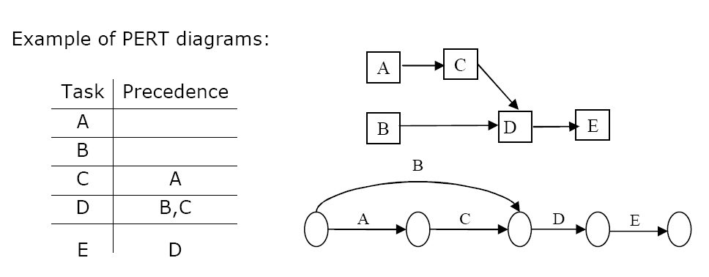
PERT Diagrams
Activity-on-node
Activity-on-arrow
Notes:
Maria Petridou
University of Nottingham

Slide 204
PERT Diagrams
Some basic rules for Activity –on-arrow:
  Tasks are represented as arrows
  Nodes represent the start and finish points of tasks
  There is only one overall start node
  There is only one overall finish node
  Two tasks cannot share the same start and end node.
B
A
D
2
3
C
Tasks B & C share the same start and end node
Notes:
Maria Petridou
University of Nottingham

Slide 205
Dummy Activities
Sometimes it is necessary to insert dummy activities (duration zero) in order to maintain the clarity of the diagram and the precedence relationships between activities.
In activity-on-arrow PERT diagrams, each activity must be uniquely identifiable by its start and end nodes.
However, sometimes multiple tasks have the same predecessors and successors.
Notes:
Maria Petridou
University of Nottingham

Slide 206
Dummy Activities
Case One
A task should be uniquely identifiable from its start node and finish node
  This means that two or more tasks cannot share the same start and finish nodes
B
1
A
2
3
D
4
Task D has immediate predecessors of B and C
C
Tasks B and C have the same start and finish nodes
Notes:
Maria Petridou
University of Nottingham

Slide 207
Dummy Activities
Inserting a dummy activity can ensure that multiple tasks have different successors.
A
B
D
1
2
3
5
C
A new node is inserted to give C a different finish node to B
A dummy task is inserted to preserve the immediate predecessors of D
4
Notes:
Maria Petridou
University of Nottingham

Slide 208
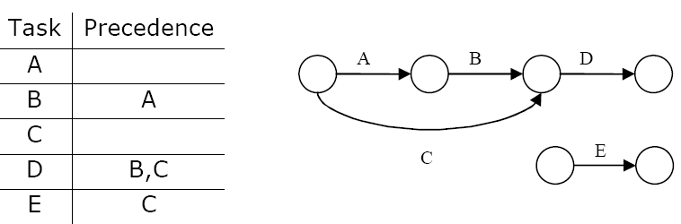
Dummy Activities
Case Two
A task should be uniquely identifiable from its start node and finish node
  This also means that a task cannot have more than one start node and one finish node
  In other words… two different arrows cannot represent the same task.
Notes:
Maria Petridou
University of Nottingham

Slide 209
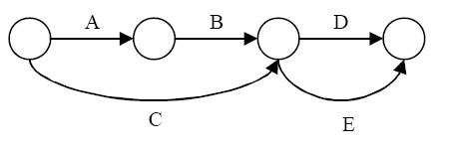
Dummy Activities
Possible Solution One
One option would be to insert activity E as shown below, but this changes the precedence of E and provokes that D and E share both start and end nodes.
Ending node of task B and C, but task C has a precedence ONLY task C
Task D and E have same start and end nodes
Notes:
Maria Petridou
University of Nottingham

Slide 210
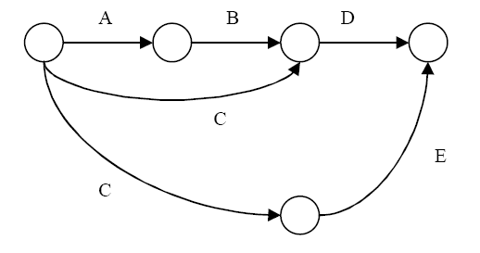
Dummy Activities
Possible Solution Two
Another option would be to insert activity E as shown below, but this provokes C to have two different end nodes.
Two ending nodes for Task C
Notes:
Maria Petridou
University of Nottingham

Slide 211
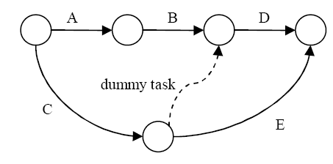
Dummy Activities
Correct Solution!
The solution is to insert a dummy task so that the precedence of E is preserved and activity C remains uniquely identifiable.
Notes:
Maria Petridou
University of Nottingham

Slide 212
CPM – Critical Path Method
It is determined by adding the times for the activities in each sequence.
CPM determines the total calendar time required for the project.
If activities outside the critical path speed up or slow down (within limits), the total project time does not change.
The amount of time that a non-critical activity can be delayed without delaying the project is called slack-time.
Notes:
Maria Petridou
University of Nottingham

Slide 213
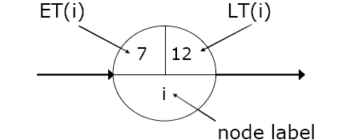
CPM – Critical Path Method
ET – Earliest node time for given activity duration and precedence relationships
LT – Latest node time assuming no delays
ES – Activity earliest start time
LS – Activity latest start time
EF – Activity earliest finishing time
LF – Activity latest finishing time
Slack Time – Maximum activity delay time
Notes:
Maria Petridou
University of Nottingham

Slide 214
CPM – Critical Path Method
Step 1. Calculate ET for each node.
For each node i for which predecessors j are labelled with ET(j), ET(i) is given
by:
ET(i)= maxj [ET(j)+ t(j,i)]
where t(j,i) is the duration of task between nodes (j,i).
Step 2. Calculate LT for each node.
For each node i for which successors j are labelled with LT(j), LT(i) is given by:
LT(i)= minj [LT(j) – t(i,j)]
where t(j,i) is the duration of task between nodes (i,j).
Notes:
Maria Petridou
University of Nottingham

Slide 215
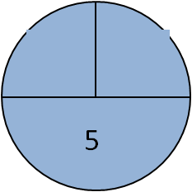
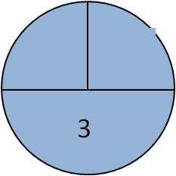

CPM – Critical Path Method
A ( 3 )
2
D ( 5 )
1
B ( 4 )
E ( 2 )
C ( 7 )
Notes:
Maria Petridou
University of Nottingham

Slide 216
CPM – Critical Path Method
A ( 3 )
2
D ( 5 )
0
1
B ( 4 )
E ( 2 )
C ( 7 )
Notes:
Maria Petridou
University of Nottingham

Slide 217
CPM – Critical Path Method
3
A ( 3 )
2
D ( 5 )
0
1
B ( 4 )
E ( 2 )
4
C ( 7 )
Notes:
Maria Petridou
University of Nottingham

Slide 218
CPM – Critical Path Method
3
A ( 3 )
2
D ( 5 )
0
1
B ( 4 )
E ( 2 )
4
C ( 7 )
11
Notes:
Maria Petridou
University of Nottingham

Slide 219
CPM – Critical Path Method
3
13
A ( 3 )
2
D ( 5 )
0
1
B ( 4 )
E ( 2 )
4
C ( 7 )
11
Software Project Management
Maria Petridou
Notes:
Maria Petridou
University of Nottingham

Slide 220
CPM – Critical Path Method
3
13
A ( 3 )
2
D ( 5 )
8
0
1
B ( 4 )
E ( 2 )
4
C ( 7 )
11
Software Project Management
Maria Petridou
Notes:
Maria Petridou
University of Nottingham

Slide 221
CPM – Critical Path Method
3
13
A ( 3 )
8
max
2
D ( 5 )
0
1
B ( 4 )
E ( 2 )
4
C ( 7 )
11
Software Project Management
Maria Petridou
Notes:
Maria Petridou
University of Nottingham

Slide 222
CPM – Critical Path Method
3
A ( 3 )
2
D ( 5 )
0
13
1
B ( 4 )
E ( 2 )
4
C ( 7 )
11
Notes:
Maria Petridou
University of Nottingham

Slide 223
CPM – Critical Path Method
3
A ( 3 )
2
D ( 5 )
0
13
13
1
B ( 4 )
E ( 2 )
4
C ( 7 )
11
Notes:
Maria Petridou
University of Nottingham

Slide 224
CPM – Critical Path Method
3
A ( 3 )
2
D ( 5 )
0
13
13
1
B ( 4 )
E ( 2 )
4
C ( 7 )
11
11
Notes:
Maria Petridou
University of Nottingham

Slide 225
CPM – Critical Path Method
3
8
A ( 3 )
2
D ( 5 )
0
13
13
1
B ( 4 )
E ( 2 )
4
C ( 7 )
11
11
Notes:
Maria Petridou
University of Nottingham

Slide 226
CPM – Critical Path Method
3
8
A ( 3 )
2
D ( 5 )
0
13
13
1
B ( 4 )
E ( 2 )
4
4
C ( 7 )
11
11
Notes:
Maria Petridou
University of Nottingham

Slide 227
CPM – Critical Path Method
5
3
8
A ( 3 )
2
D ( 5 )
0
13
13
1
B ( 4 )
E ( 2 )
4
4
C ( 7 )
11
11
Software Project Management
Maria Petridou
Notes:
Maria Petridou
University of Nottingham

Slide 228
CPM – Critical Path Method
5
3
8
0
A ( 3 )
2
D ( 5 )
0
13
13
1
B ( 4 )
E ( 2 )
4
4
C ( 7 )
11
11
Software Project Management
Maria Petridou
Notes:
Maria Petridou
University of Nottingham

Slide 229
CPM – Critical Path Method
5
3
8
min
0
A ( 3 )
2
D ( 5 )
0
13
13
1
B ( 4 )
E ( 2 )
4
4
C ( 7 )
11
11
Software Project Management
Maria Petridou
Notes:
Maria Petridou
University of Nottingham

Slide 230
CPM – Critical Path Method
3
8
A ( 3 )
2
D ( 5 )
0
0
13
13
1
B ( 4 )
E ( 2 )
4
4
C ( 7 )
11
11
Notes:
Maria Petridou
University of Nottingham

Slide 231

CPM – Critical Path Method
An activity with zero slack time is a critical activity and cannot be delayed without causing a delay in the whole project.
Notes:
Maria Petridou
University of Nottingham

Slide 232
CPM – Critical Path Method
Step 3. Calculate processing times for each activity.
For each activity X with start node i and end node j:
ES(X) = ET(i)
EF(X) = ES(X) + t(X)
LF(X) = LT(j)
LS(X) = LF(X) – t(X)
Slack Time (X) = LS(X) – ES(X) = LF(X) – EF(X)
Where t(X) is the duration of activity X.
An activity with zero slack time is a critical activity and cannot be delayed without causing a delay in the whole project.
Notes:
Maria Petridou
University of Nottingham

Slide 233
CPM – Critical Path Method
Step 3. Calculate processing times for each activity.
Task | Duration | ES | EF | LS | LF | Slack | Critical Task
A | 3 | 0 | 3 | 5 | 8 | 5 | No
B | 4 | 0 | 4 | 0 | 4 | 0 | Yes
C | 7 | 4 | 11 | 4 | 11 | 0 | Yes
D | 5 | 3 | 8 | 8 | 13 | 5 | No
E | 2 | 11 | 13 | 11 | 13 | 0 | Yes
Reading: (Kendall&Kendall, chapter 3), (Dennis &Wixom, chapter 3)
Notes:
Maria Petridou
University of Nottingham

Slide 234
CPM – Critical Path Method
3
8
A ( 3 )
2
D ( 5 )
0
0
13
13
1
B ( 4 )
E ( 2 )
4
4
C ( 7 )
11
11
Notes:
Maria Petridou
University of Nottingham

